Slide 1
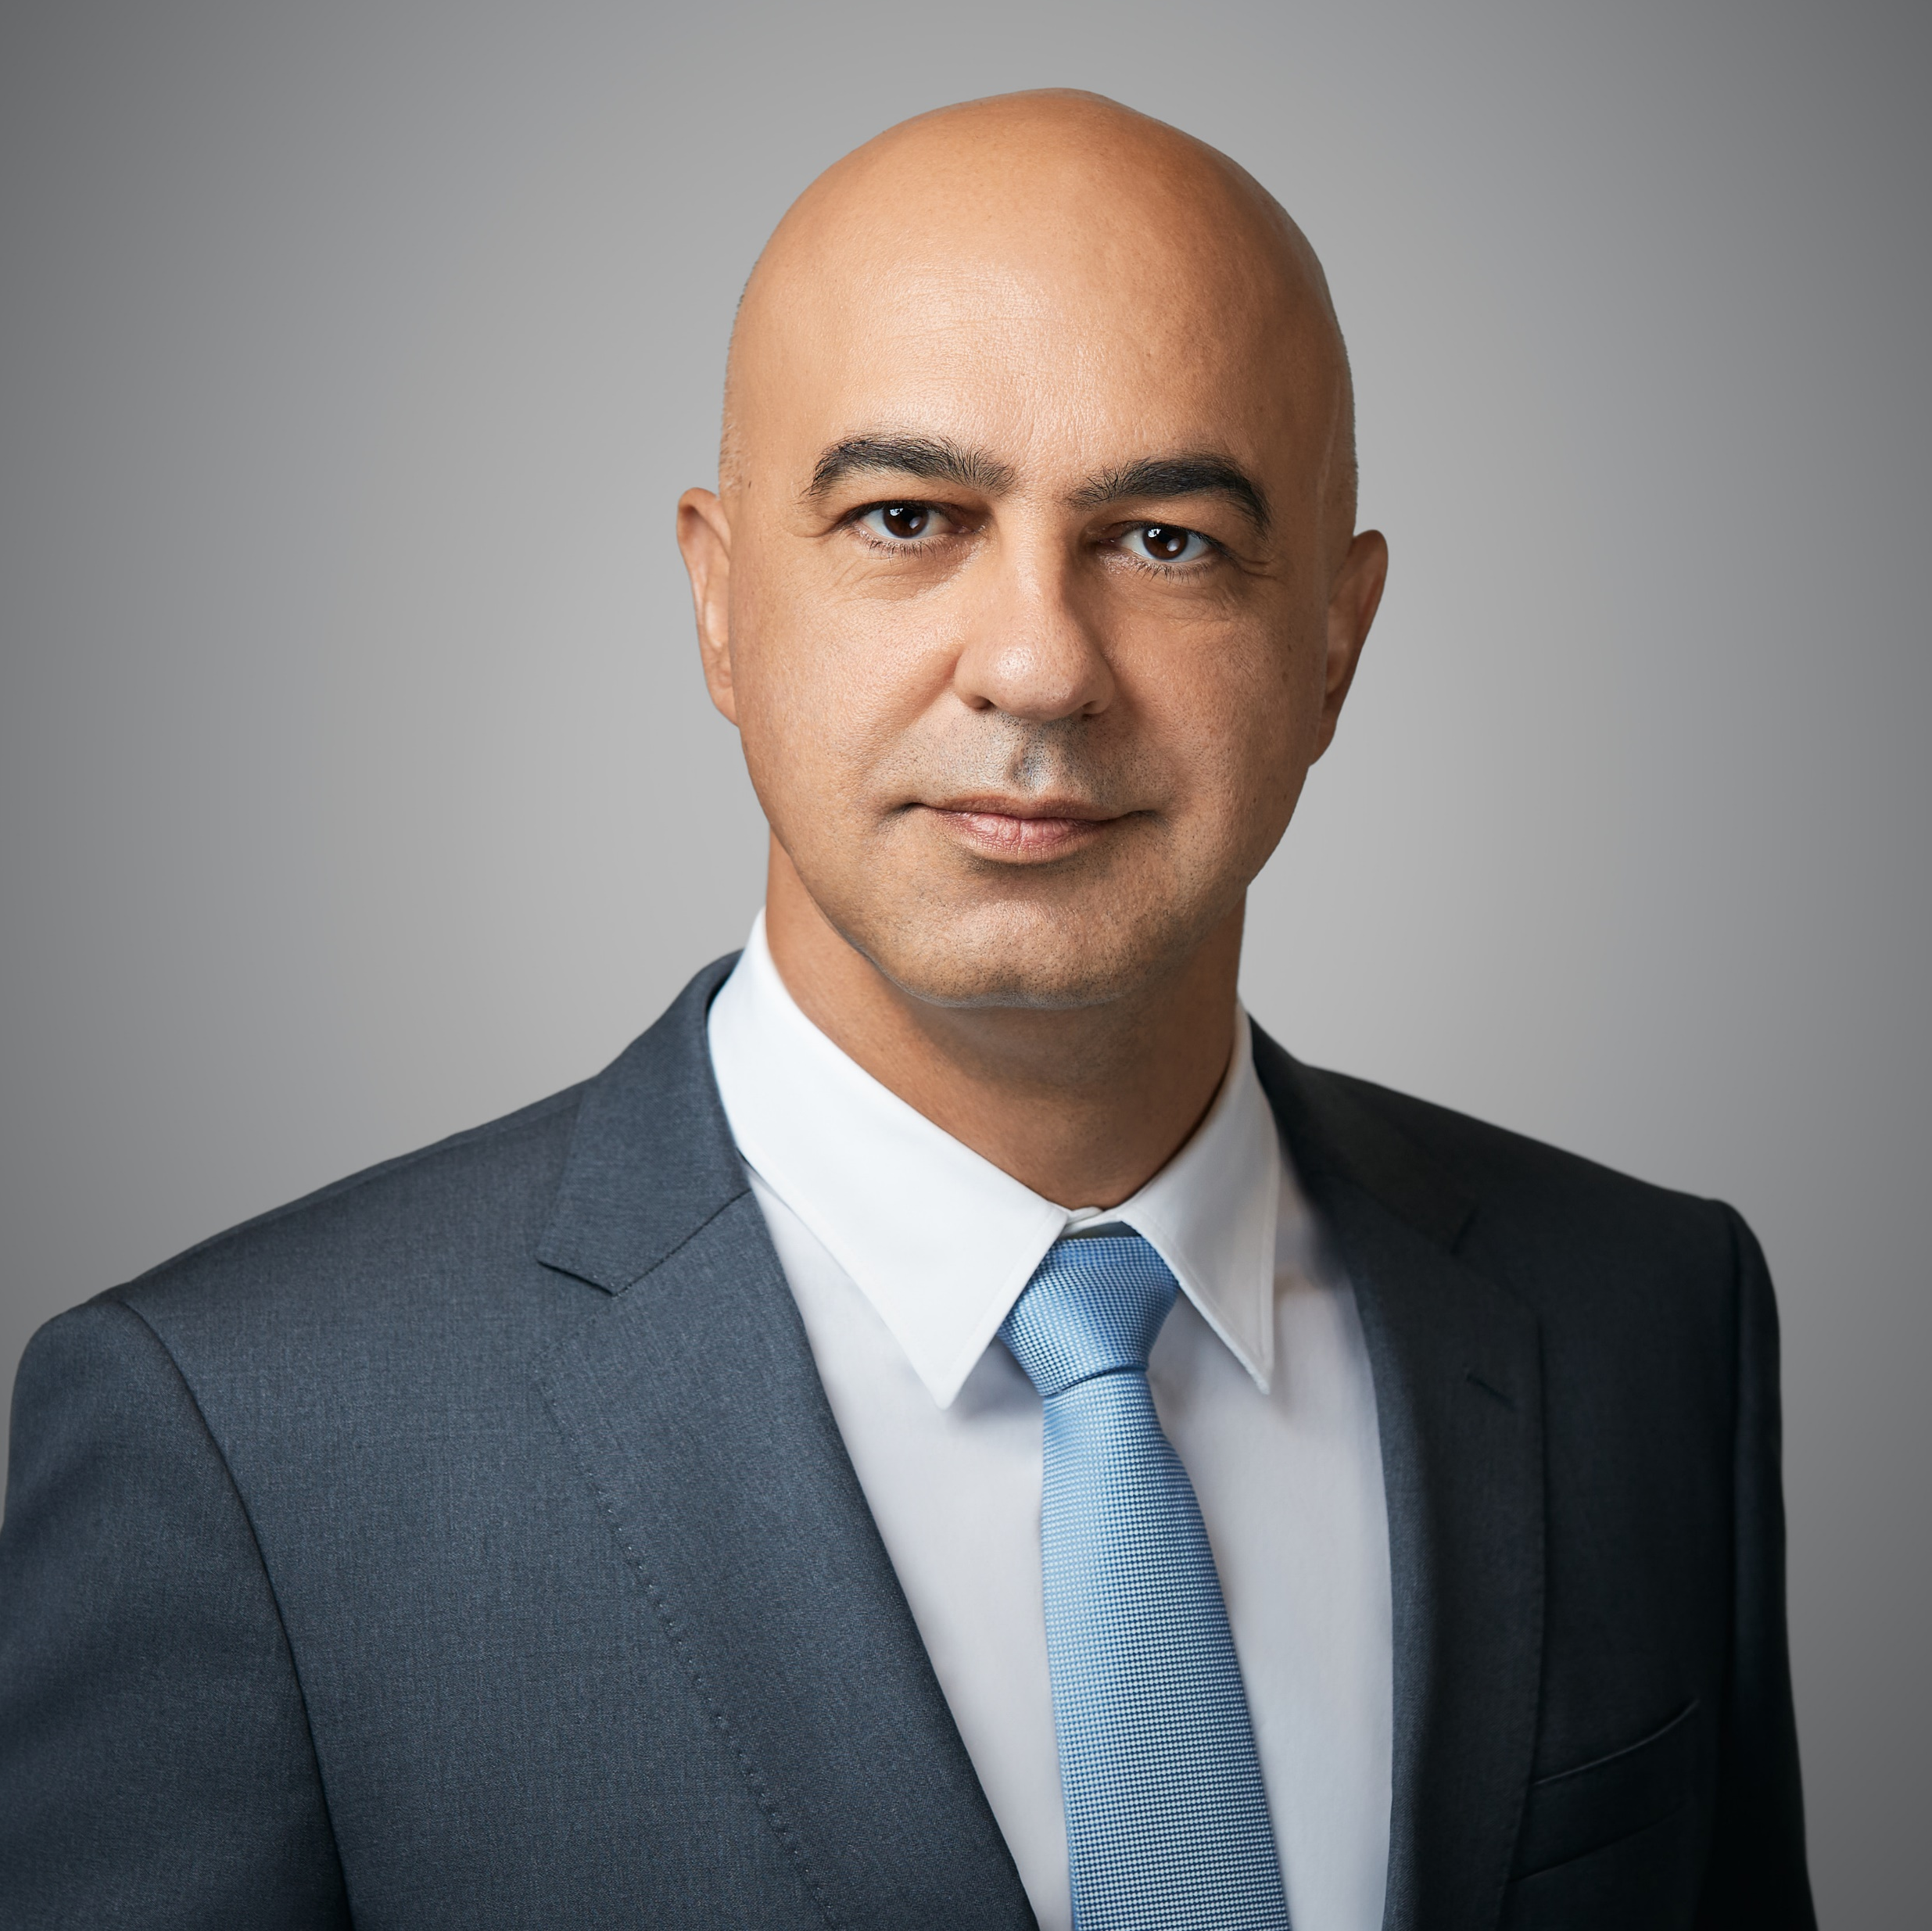
ESG in Financial Services
Dr George Theocharides, Chairman
Cyprus Securities and Exchange Commission

Slide 2
CySEC’s Vision and Mission
Exercise effective supervision to ensure investor and consumer protection and the healthy development of the securities market
Enhance the Cyprus securities market to make it one of the safest and most reliable investment destinations in Europe and internationally

Slide 3
CySEC and Supervised Entities
Investment Funds and Management Companies
Crowdfunding Service Providers
Cyprus Investment Firms
Trading Venues (Cyprus Stock Exchange, Multilateral Trading Facility)
Crypto Asset Service Providers
Administrative Service Providers
Listed Companies
The legal framework is fully harmonised with all the latest EU Directives and Regulations
Close cooperation with other national competent Authorities in Europe and worldwide
Active member of ESMA and IOSCO
831

Slide 4
The Market
323
Fund Management Companies and Funds
€9.1 bn
Fund Management Companies and Funds
UCITS INVESTMENT STRATEGY
AIF, AIFLNP AND RAIF INVESTMENT STRATEGY

Slide 5
Regulatory Developments
The EU published a regulation aimed at ensuring the transparency and integrity of ESG rating activities, addressing concerns regarding the lack of clarity in ESG ratings and their methodologies.
EU SF framework: introduced a comprehensive regulatory framework including the Sustainable Finance Disclosure Regulation (SFDR), the EU Taxonomy Regulation, and the Corporate Sustainability Reporting Directive referred to as CSRD.
The European Commission adopted sustainability standards under MiCAR (regarding crypto-asset issuers and service providers)
Plans to decide in 2025 whether to transition the SFDR framework from a disclosure-based regime to a product categorization
The development of a social taxonomy is being prioritized to assess investments pursuing social objectives
Amendments made to the main legislation, including MiFID II and AIFMD

Slide 6
ESMA Guidance
ESMA and CySEC have issued important guidance.
ESMA has published detailed technical advice on the SFDR and EU Taxonomy’s application, including Q&A documents, a supervisory briefing, and sector-specific guidelines. (ie. “Guidelines on funds' names using ESG or sustainability-related terms”)
June 2024: ESMA published the Final Report on Greenwashing

Slide 7
CySEC keeps up-to-date with the best supervisory practices, ensuring we can maintain and enhance
the way we protect investors
AUTHORISATION, SUPERVISION
AND LEGISLATION
The obligations under the ESG Disclosures Regulation
The EU sustainability goals and the European Green Deal
Guidance and circulars on compliance with the ESG obligations
Risk-Based Supervision Framework - “ESG Risk Management Framework for the Financial Sector”
The ESG Ratings Regulation

Slide 8
ESG landscape in Cyprus
A high number of Cypriot fund managers have not yet created funds with ESG orientation
investment managers to realise the need and importance of redirecting their focus to ESG oriented products
CySEC is currently working on the issuance of a more elaborative guidance, with the aim of ensuring Cypriot Managers’ enhanced understanding on the importance for a turn to a more ESG oriented investment horizon
To provide analytical guidance on compliance with the disclosure obligations and internal policies and procedures obligations, stemming from the relevant regulatory framework as well as inform them of the changes envisaged to the current regulatory framework

Slide 9
Sustainability
ESG in European markets is poised to create a more sustainable, transparent, and socially responsible business environment.
As a small island nation facing climate threats firsthand in the Eastern Mediterranean region, Cyprus recognises the imperative in achieving net-zero emissions by 2050 alongside the EU’s other environmental targets.

Slide 10
CySEC’s initiatives
Developing further practical guidance for the market.
Actively participates in supervisory initiatives at the EU level. The Supervision Department participates in ESMA’s Common Supervisory Actions on sustainability-related topics, such as sustainability disclosures and the integration of sustainability risks into investment funds, as well as MiFID II sustainability requirements in the suitability assessment.
Initiatives to the ESG data. CySEC is one of the 12 national competent authorities participating in a flagship European project designed at strengthening ESG Risk supervision and ESG data management, ensuring more effective and robust regulatory oversight.

Slide 11
Investors’ Protection
 | ESG topics are also highlighted in our online financial literacy campaigns, which are promoted through both traditional media and social media platforms
At CySEC, we are deeply committed to educating investors about sustainable investing and the importance of ESG considerations
A dedicated ESG page
on CySEC’s Website
CySEC Investor Guide
to Sustainable Investing

Slide 12
CySEC’s Expectations
The integration of ESG considerations into the financial services sector is a regulatory requirement.
CySEC expects all regulated entities in Cyprus to fully comply with the EU sustainable finance framework.
The local ESG financial market remains in its early stages. CySEC will continue to monitor and supervise compliance with these requirements.
Expect firms to meaningfully integrate ESG factors into their investment strategies and provide disclosures that accurately reflect these efforts. To establish robust governance structures and compliance procedures to meet regulatory standards etc.

Slide 13
Future of ESG Regulation
European companies will be forced to innovate, adapt, and align with global sustainability goals.
Regulators will be at the forefront of ensuring that ESG factors are central components of financial markets and corporate governance in Europe.
The European regulators’ role in driving the green transition, improving corporate accountability, enhancing risk management, and protecting investors will be crucial in shaping a sustainable, transparent, and resilient future for European markets.
The European Commission’s Omnibus Simplification Package is pivotal for the future of ESG in the EU, ensuring that sustainability goals are achieved while enhancing the competitiveness of EU businesses.

Slide 14
THANK YOU

